Slide 1

Fanling Kau Yan College
S1 Integrated Science
Factors affecting the rate of dissolving
Displaying your Work
Class Activities
Thinking routines
S1 I.S. Chapter 2

Slide 2

Learning Objectives
Factors affecting the rate of dissolving
LG P.1
Objectives
Knowledge:
Recognize the factors affecting the rate of dissolving.
Skill:
Perform fair tests to study how volume of water affecting the rate of dissolving.
Use AI as a data analyst to evaluate data reliability and error sources.
Attitude:
Take ownership of learning by predicting, verifying, and using AI coaching to deepen scientific reasoning.

Slide 3

School-based Phonics
Read aloud (LG P.1)
Keywords | School-based Phonics | Chinese meaning
size (noun) | s i z e | 大小
volume (noun) | v o / l u m e | 體積
temperature (noun) | t e m / p e / r a / t u r e | 溫度
mass (noun) | m a s s | 質量
stir (verb) | s t i r | 攪拌
increase (verb) | i n / c r e a s e | 上升
decrease (verb) | d e / c r e a s e | 下降

Slide 4

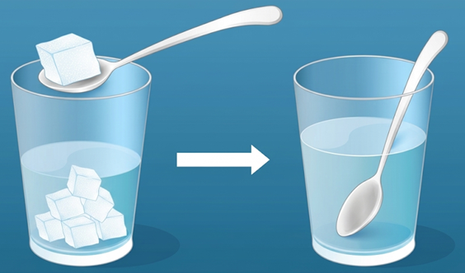

Think-pair-share
Think-pair-share (LG P.2)
You are making a a cup of hot milk tea. You want to dissolve sugar faster. What can you do?
Useful opening
I can dissolve the sugar faster by …

Slide 5
Pre-lab Session
Pre-lab Session (LG P.2)
Hypothesis | The rate of dissolving of sugar in water increases (increases / decreases) if more water is used.
Variable to be changed | Volume of water
Variables to me compared | Time needed for the sugar to completely dissolve in water
Variables to be kept constant (Put “” in the box(es)) | ☑ Temperature of water  Volume of water ☑ Mass of sugar ☑ Size of sugar pieces

Slide 6

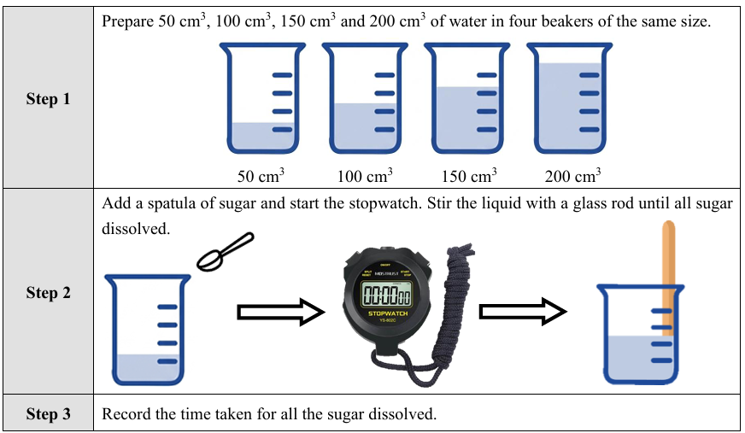
Experiment: Factors affecting rate of dissolving
Experiment (LG P.3)
How is the rate of dissolving affected by volume of water?

Slide 7
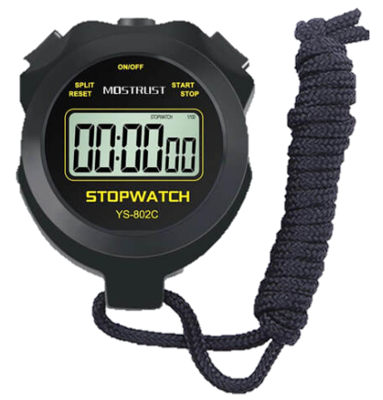
Experiment: Factors affecting rate of dissolving
Experiment (LG P.3)
Press one time: Start
Press one more time: Stop
Press one time: Reset

Slide 8

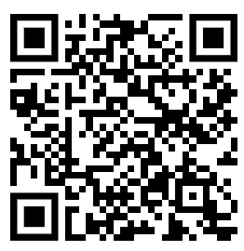
AI-assisted learning task
Interact with Agent Water
(LG P.3)

Slide 9
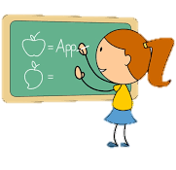
Think-pair-share
Think-pair-share
(LG P.3-4)
Writing iBoard: 3 mins
Topic 1 / 2 / 3
Group number
T | Check spelling and present.
E | Write the title and group number.
A | Write down your group’s answer
M
Useful opening
Good morning, we are members from Group _____.
To answer this question, we think that … …

Slide 10

Reflection Question
Reflection (P.4)
Why do we take average of eight groups of the reading?
Suggest limitations of this experiment and some methods to make the results more reliable.

